Slide 1

DESIGN A SERVING
MOBILE ROBOT FOR RESTAURANT
Name: Tran Minh Duc – 20181875
Tran Tuan Minh – 20181906
Ly Duc Trung – 20181930
Supervisor: Le Minh Thuy

Slide 2
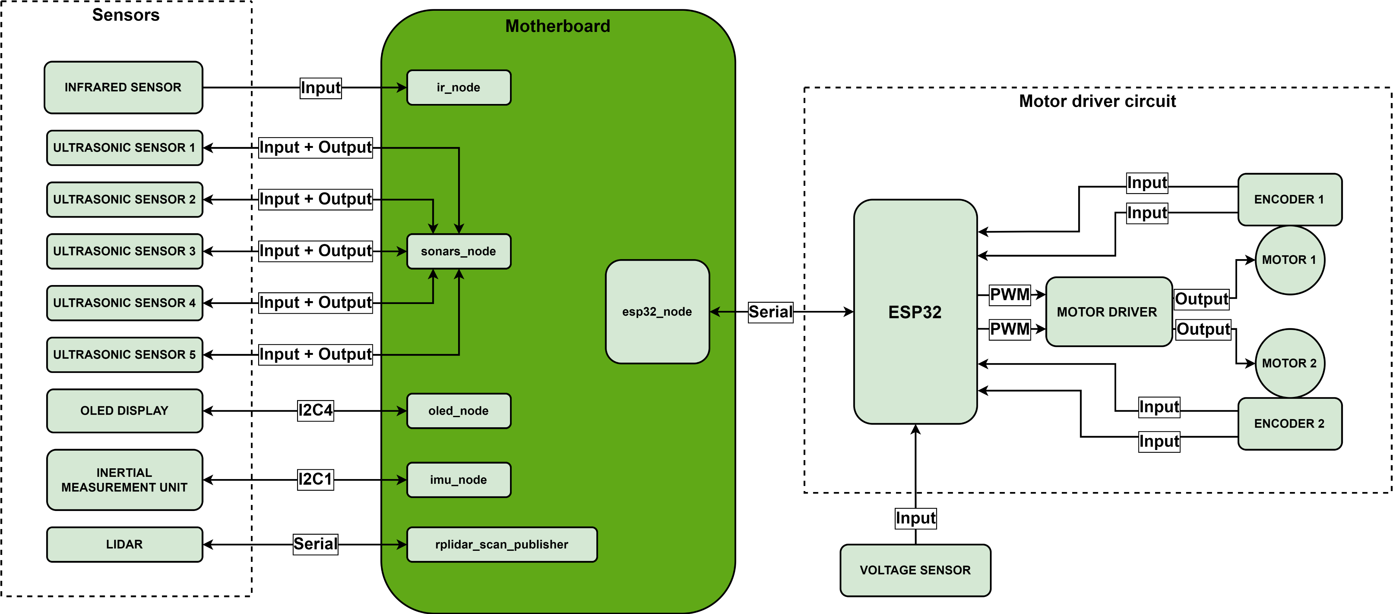
x. FIRMWARE ARCHITECTURE

Slide 3
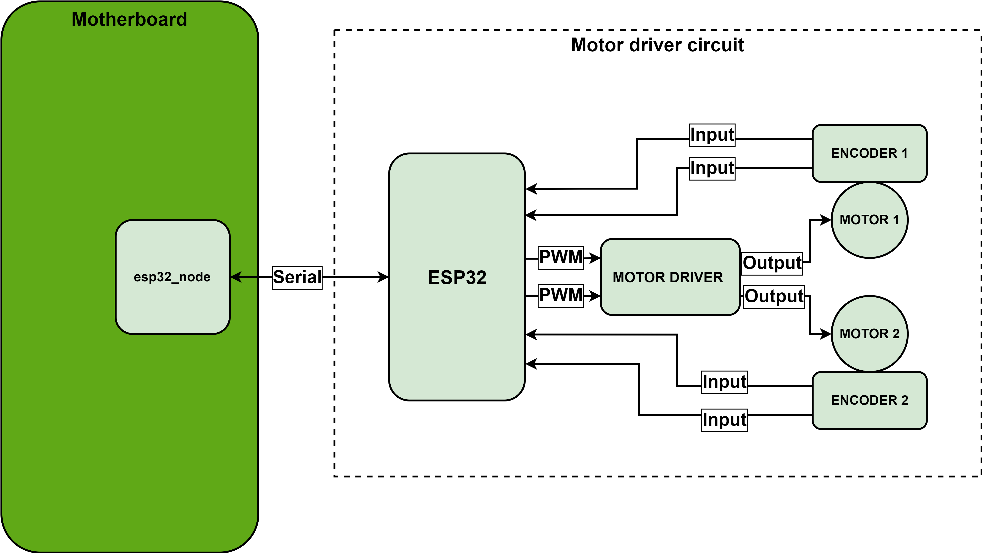
x. MOTOR DRIVER CIRCUIT

Slide 4
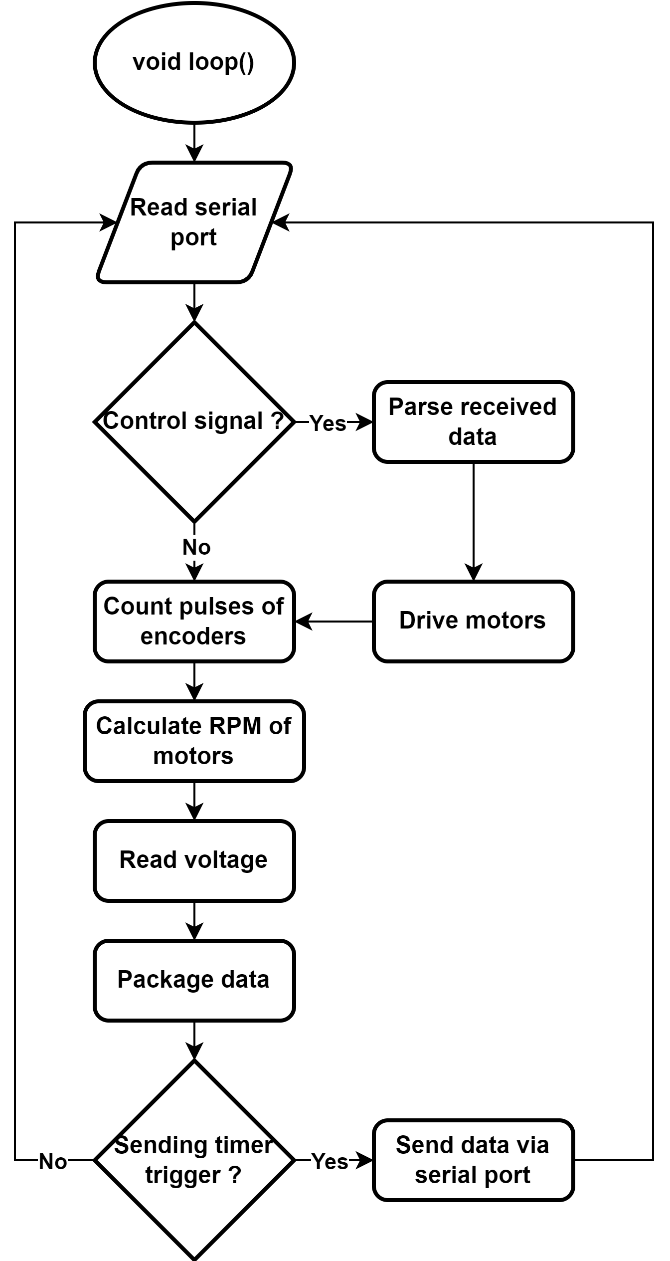
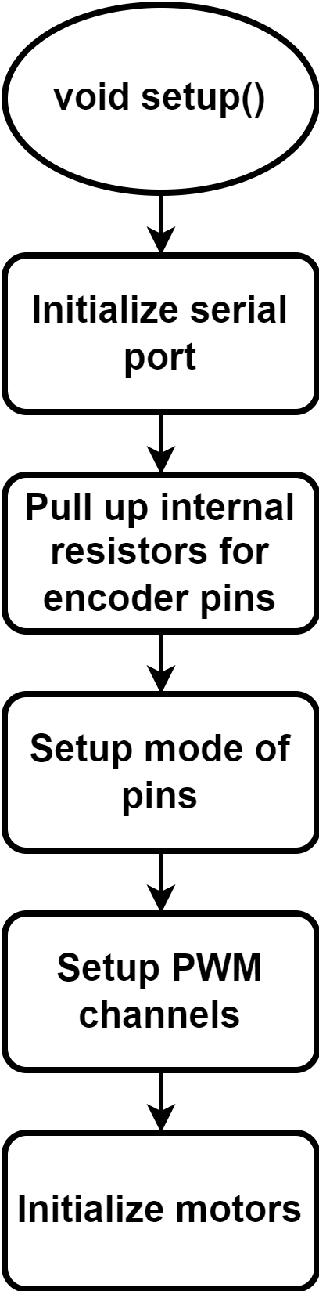
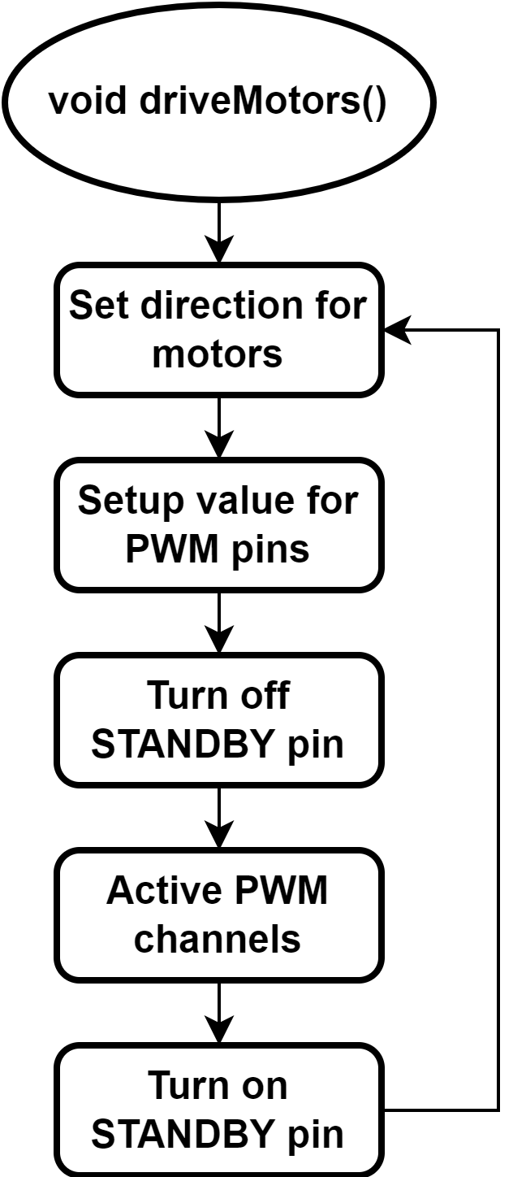
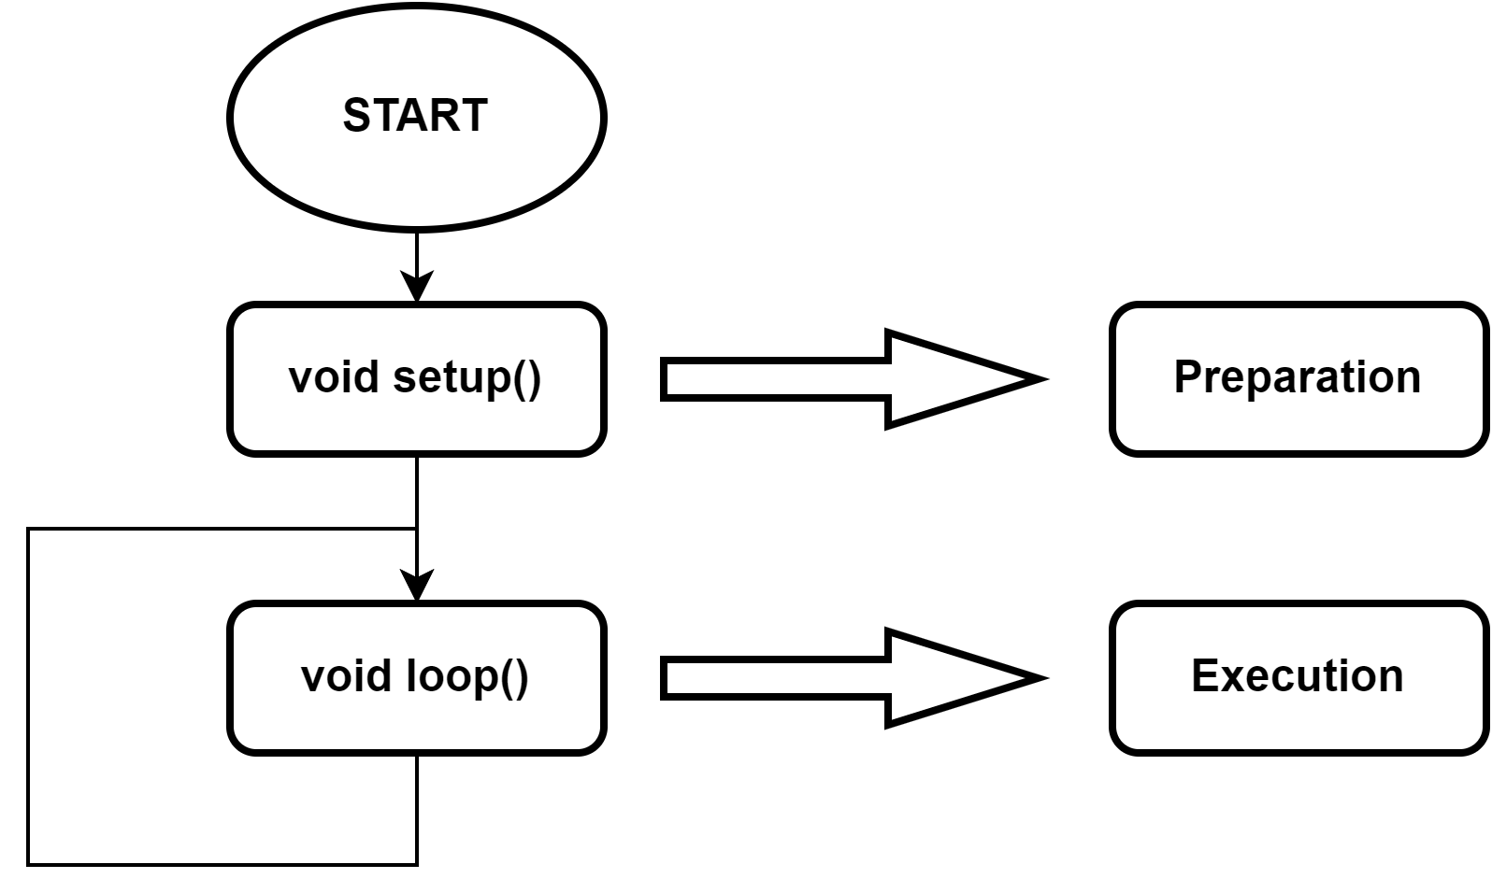
x. MOTOR DRIVER CIRCUIT – ESP32 MCU

Slide 5
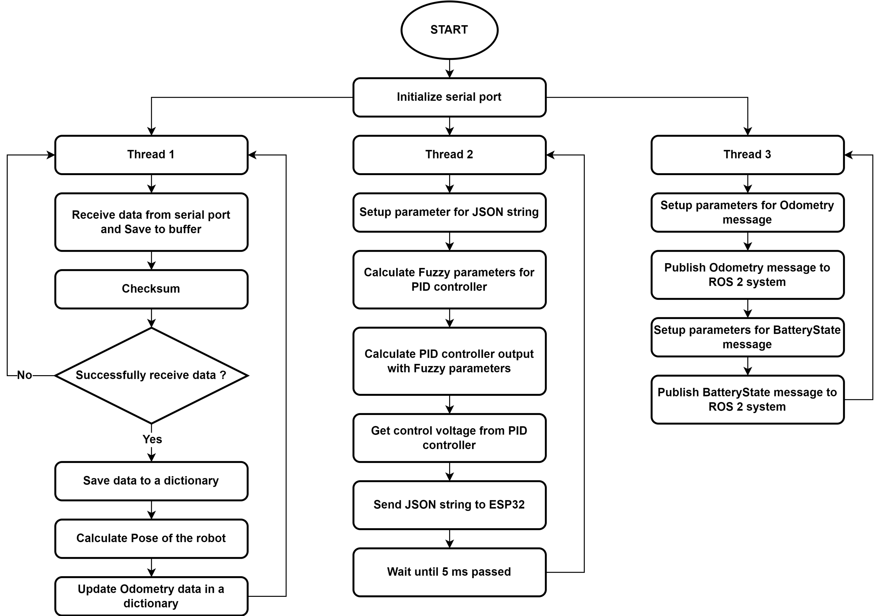
x. MOTOR DRIVER CIRCUIT – RASPBERRY PI 4

Slide 6
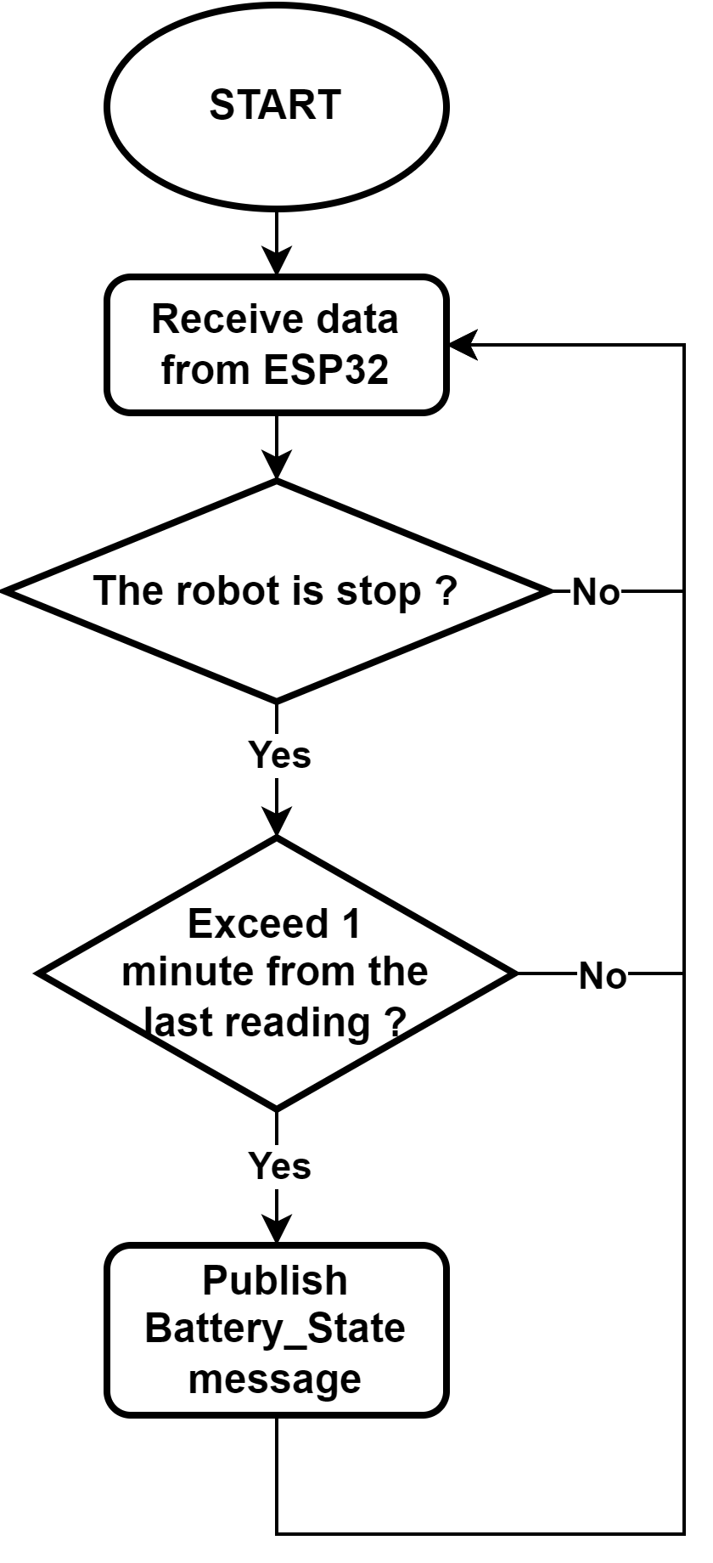
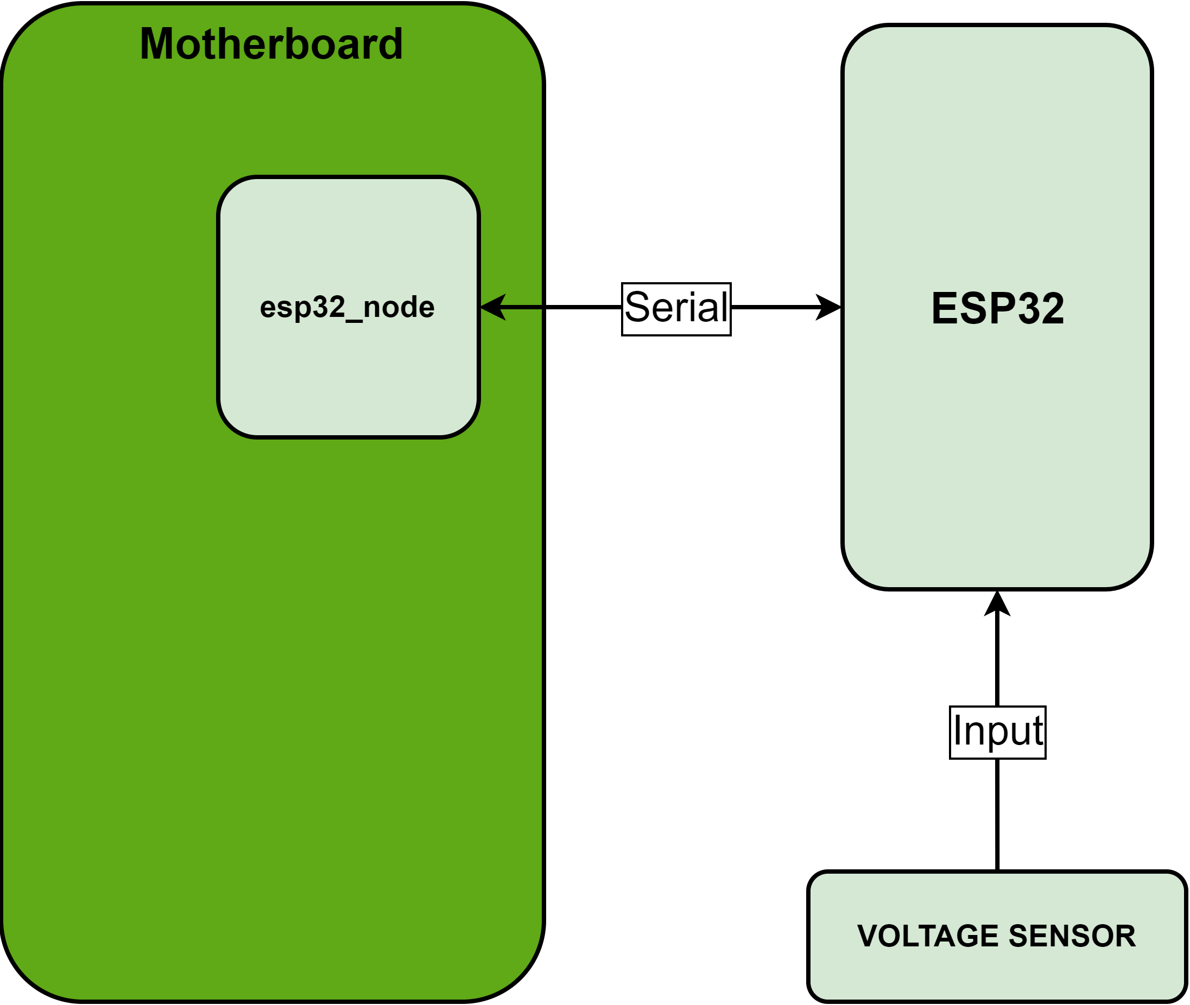
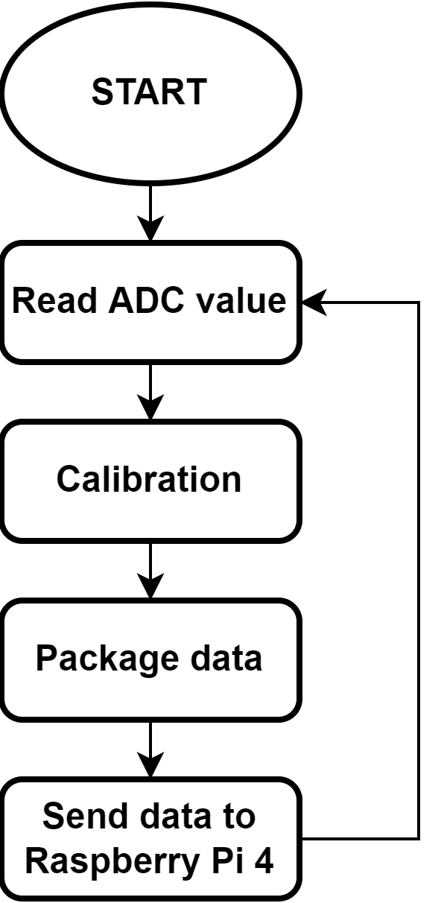
x. VOLTAGE SENSOR
Firmware for ESP32 microcontroller
Firmware for Raspberry Pi 4

Slide 7
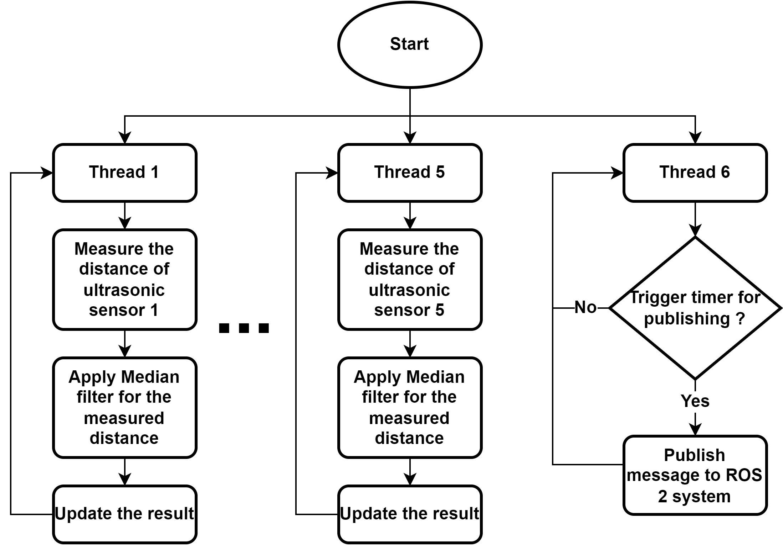
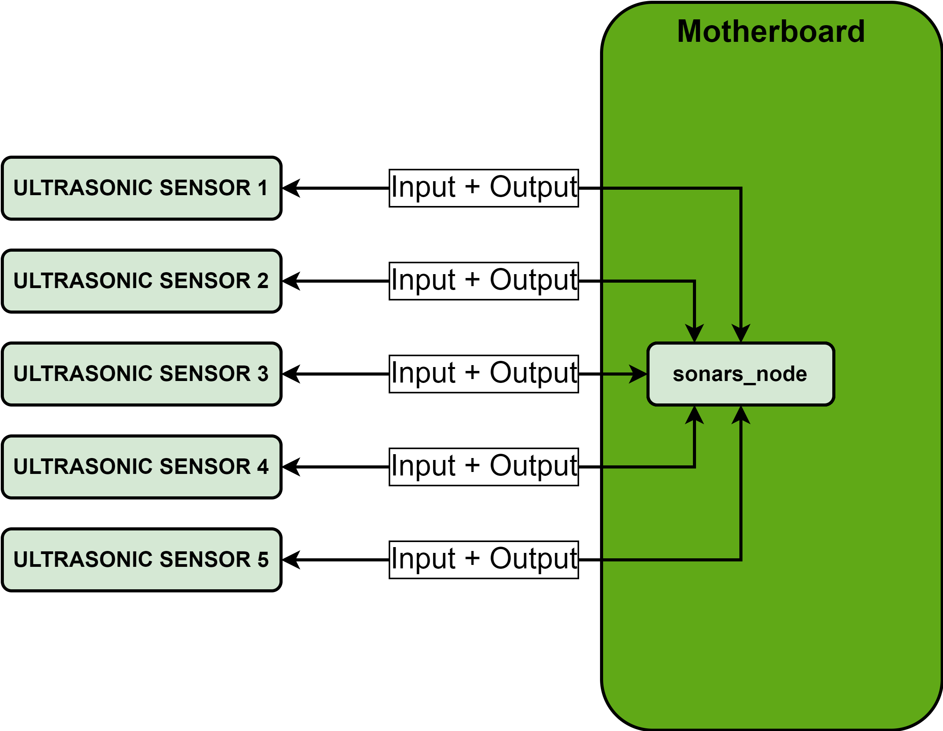
x. ULTRASONIC SENSORS

Slide 8
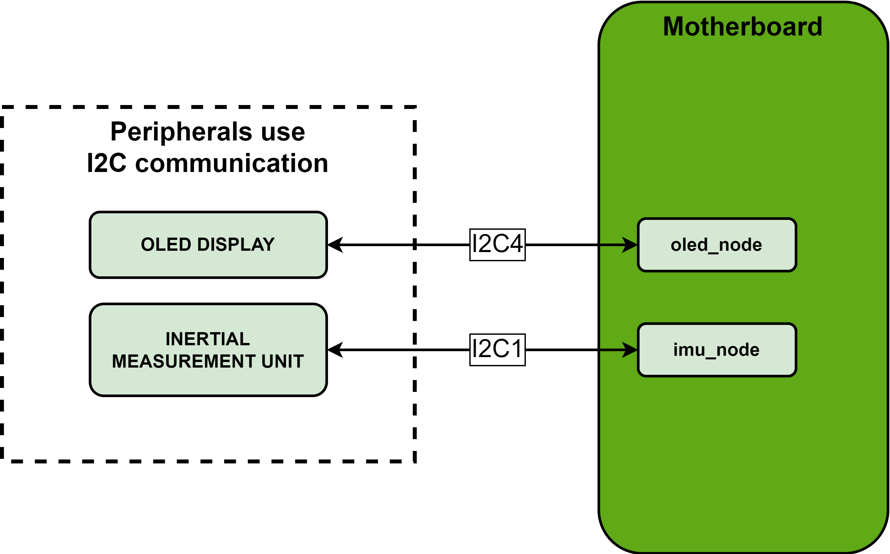
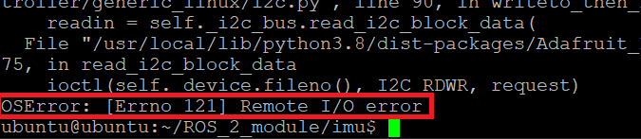
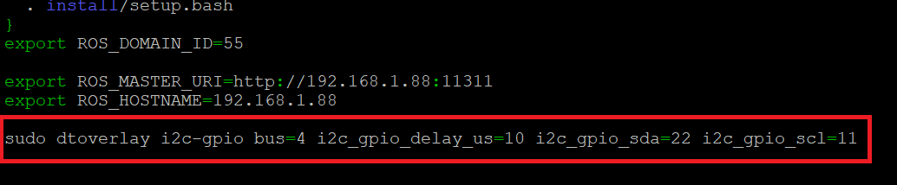
x. I2C BUSES – PROBLEM AND SOLUTION
Problem of I2C buses
Solution of I2C buses

Slide 9
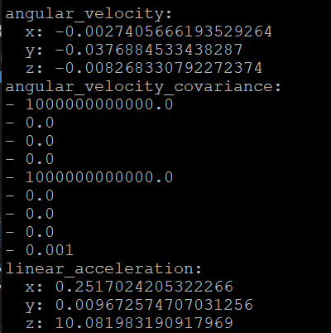
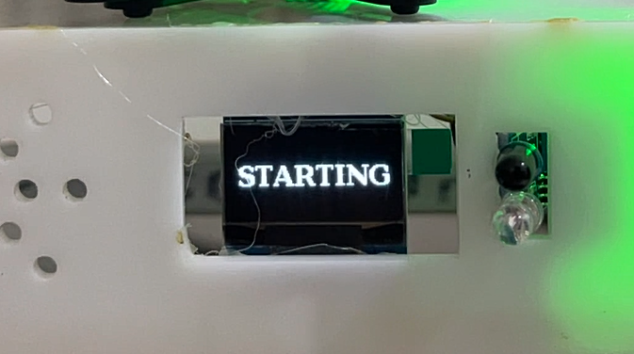
x. I2C BUSES FIXED RESULT

Slide 10
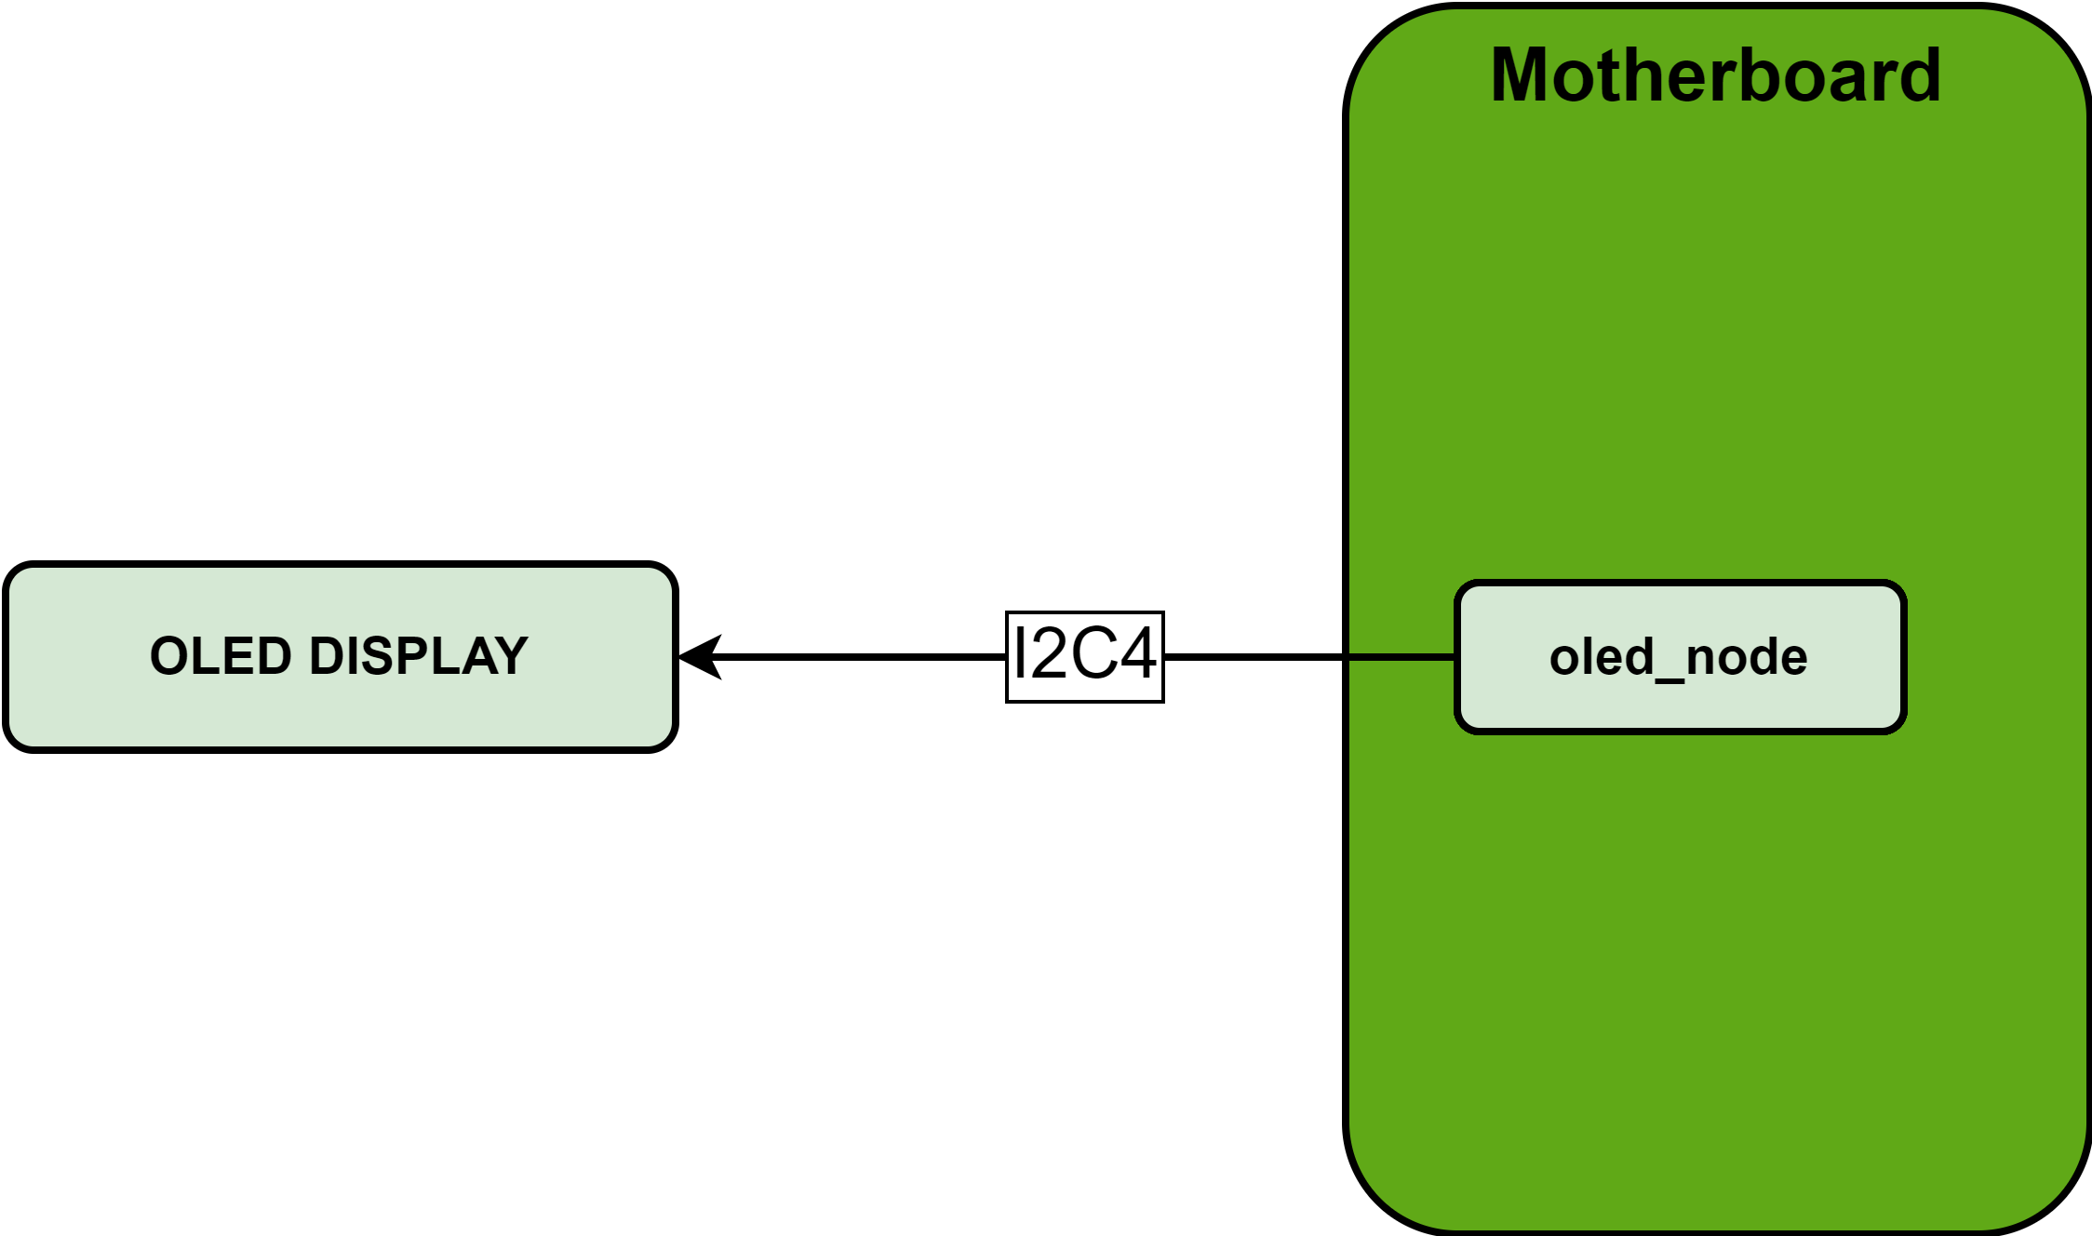
x. OLED DISLPAY

Slide 11
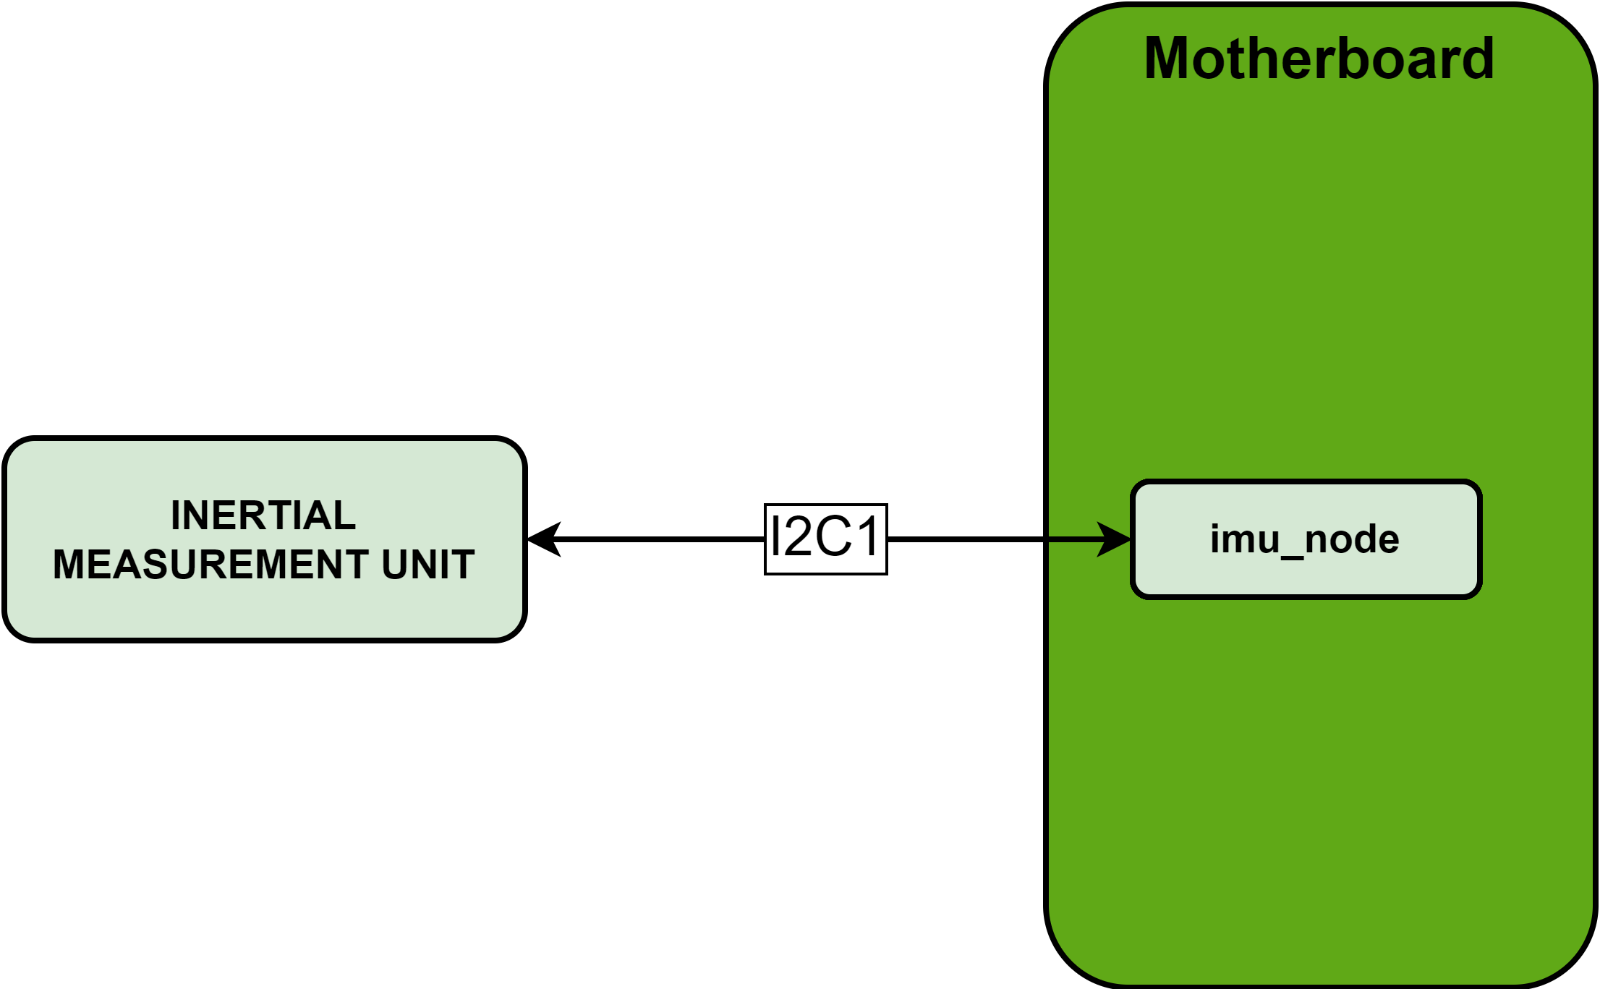
x. INERTIAL MEASUREMENT UNIT SENSOR

Slide 12
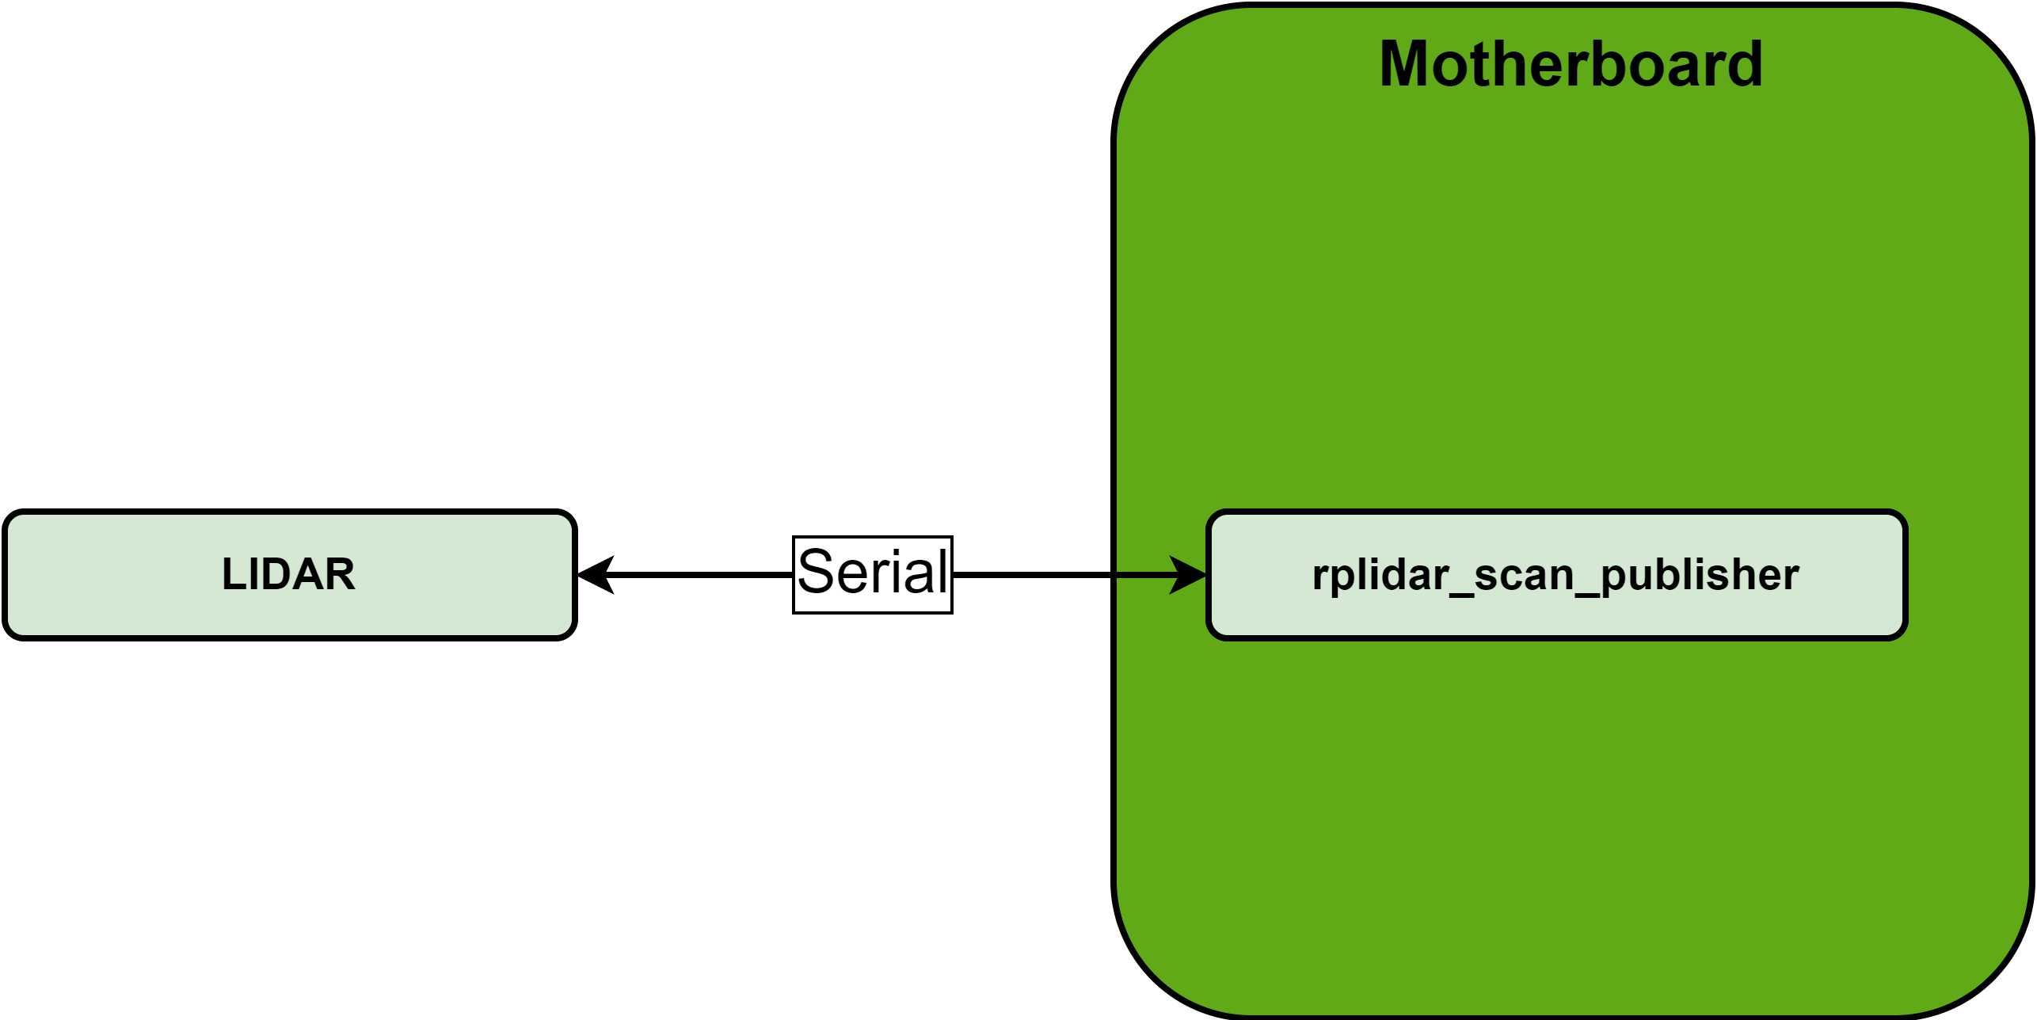
x. LIDAR SENSOR

Slide 13
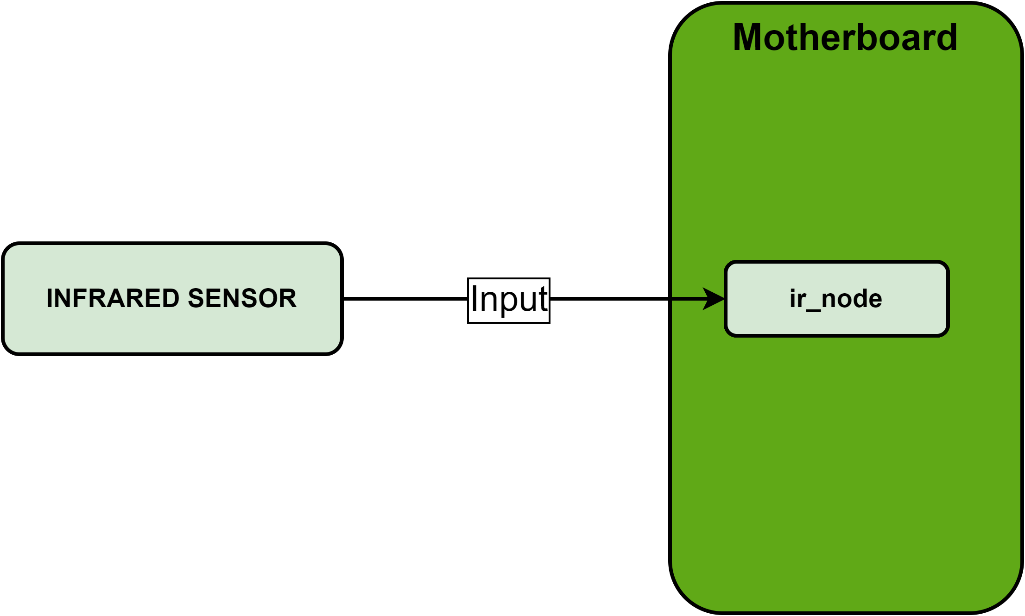
x. INFRARED SENSOR

Slide 14
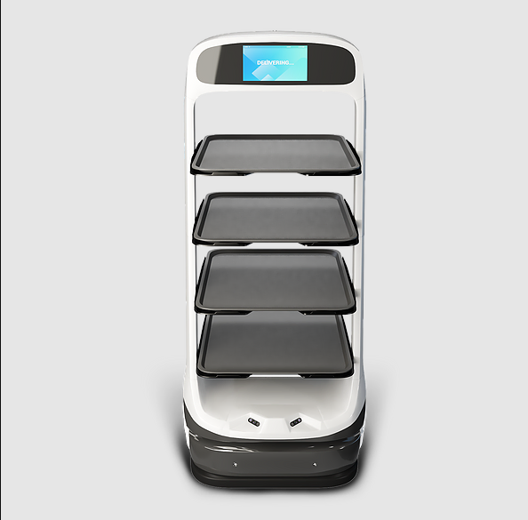
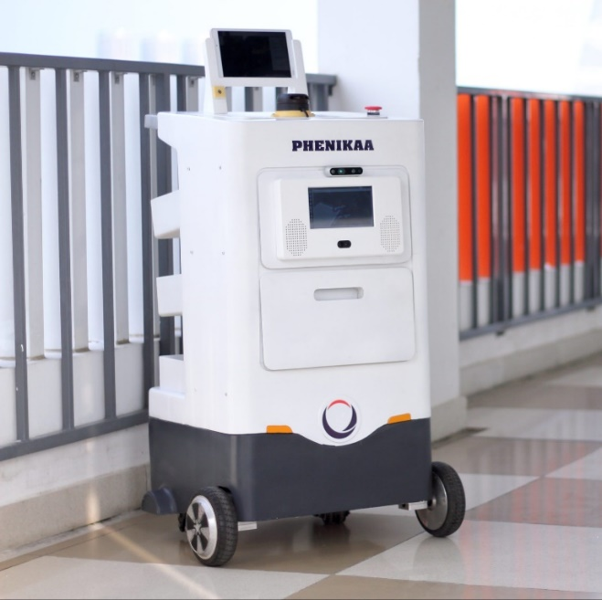
1. INTRODUCTION
Matradee Robot
Phenikaa-X delivery Robot

Slide 15
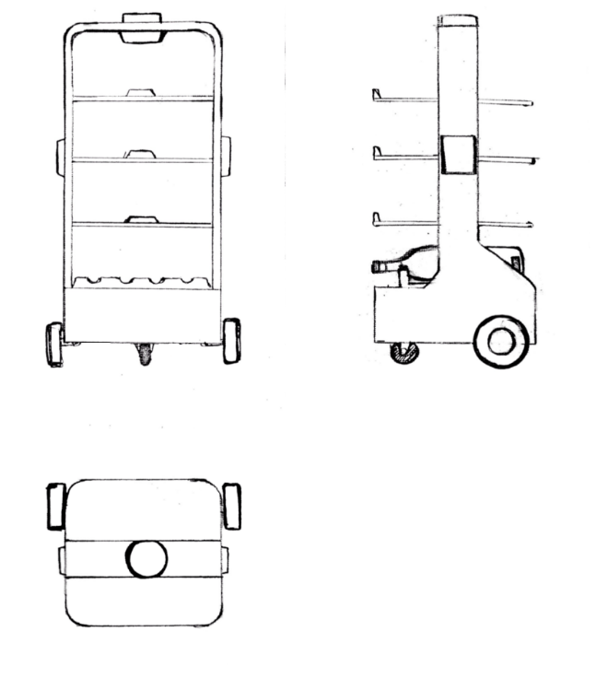
2. DESIGN IDEA
Design purpose:
+ Robot can self-navigate to the desired goal and avoid obstacles.
+ Robot can interact with customer via screen and speaker.
Specification:
+ Sensor: LiDAR, Ultrasonic sensor, IMU
+ Navigation method: SLAM
+ Body weight: 7 kg
+ Maximum load weight: 15 kg
+ Speed: 0.5 m/s
+ Power: 54 W
2D design

Slide 16
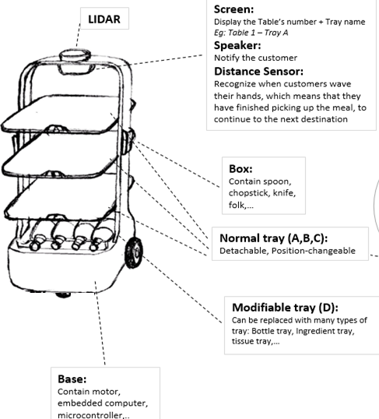
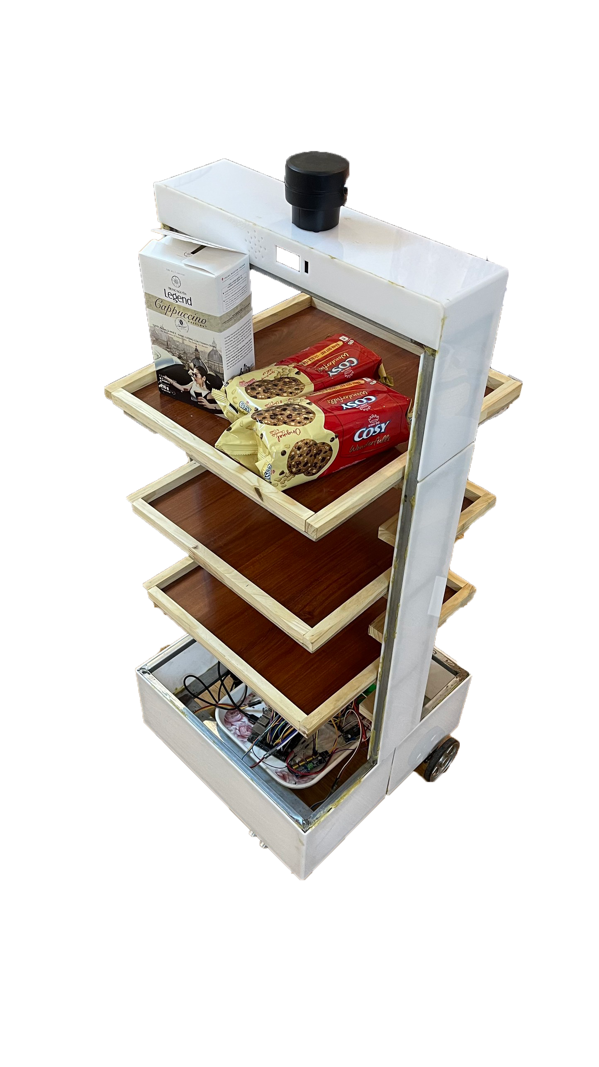
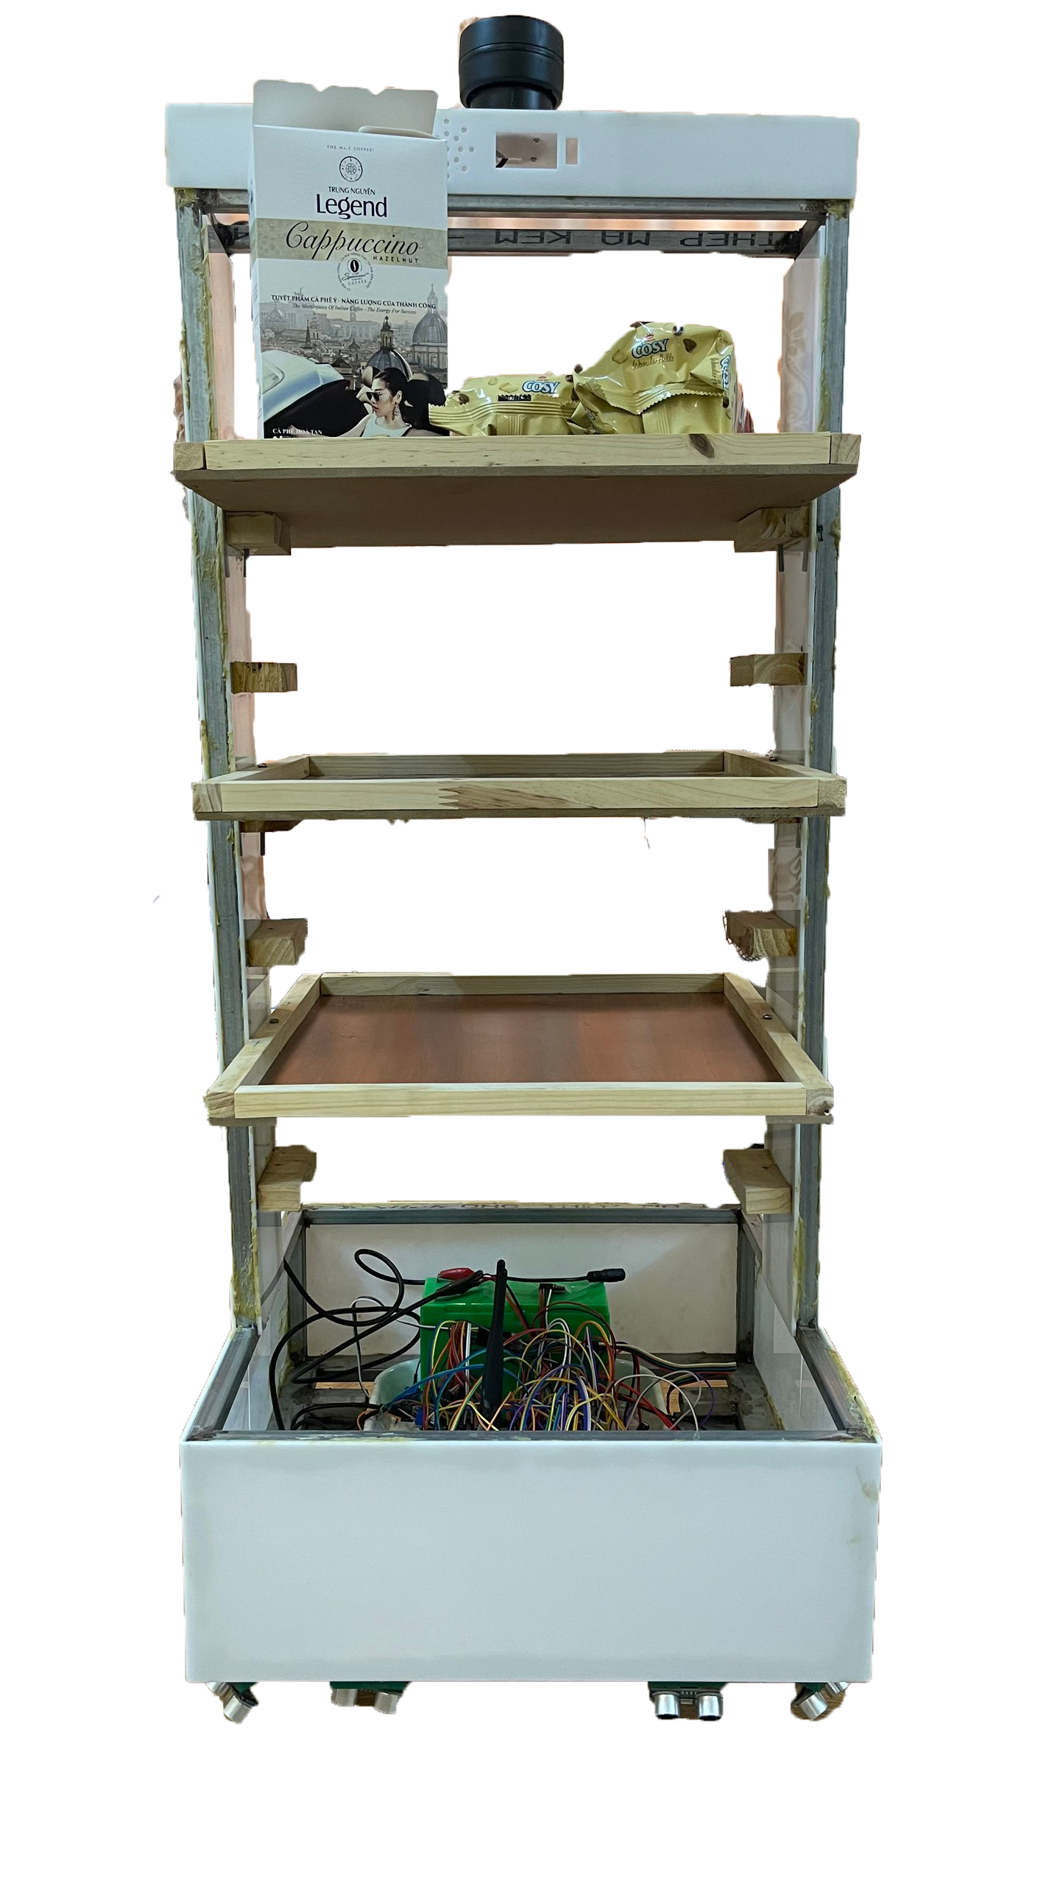
2. DESIGN IDEA

Slide 17
THANK YOU !

